Slide 1

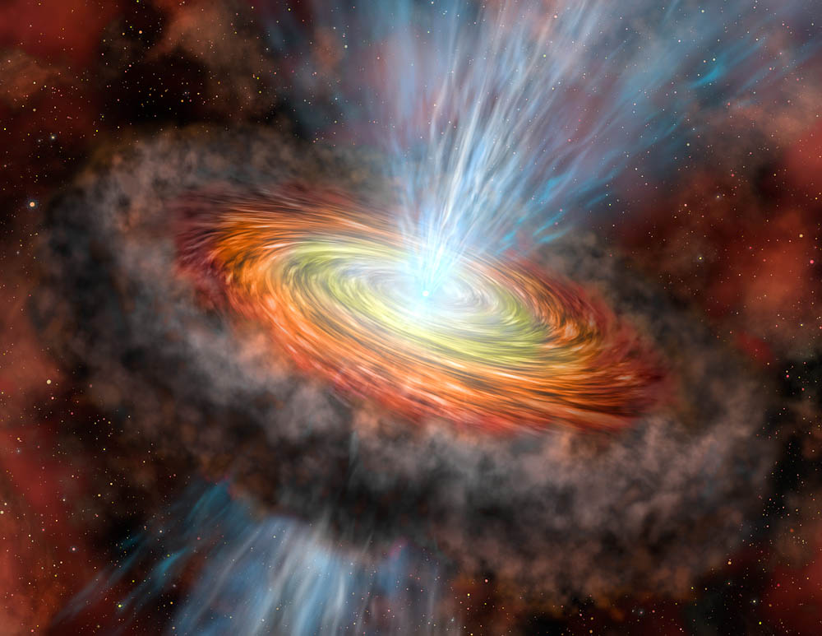
3D Simulations of Accretion disk Torus
Jung Lin (Doris) Lee (UC Berkeley)
Kengo Tomida (Princeton)
Jim Stone (Princeton)
USRP Final Presentation, 08/06/2015
Image Credit: Gemini Observatory, Lynette Cook

Slide 2
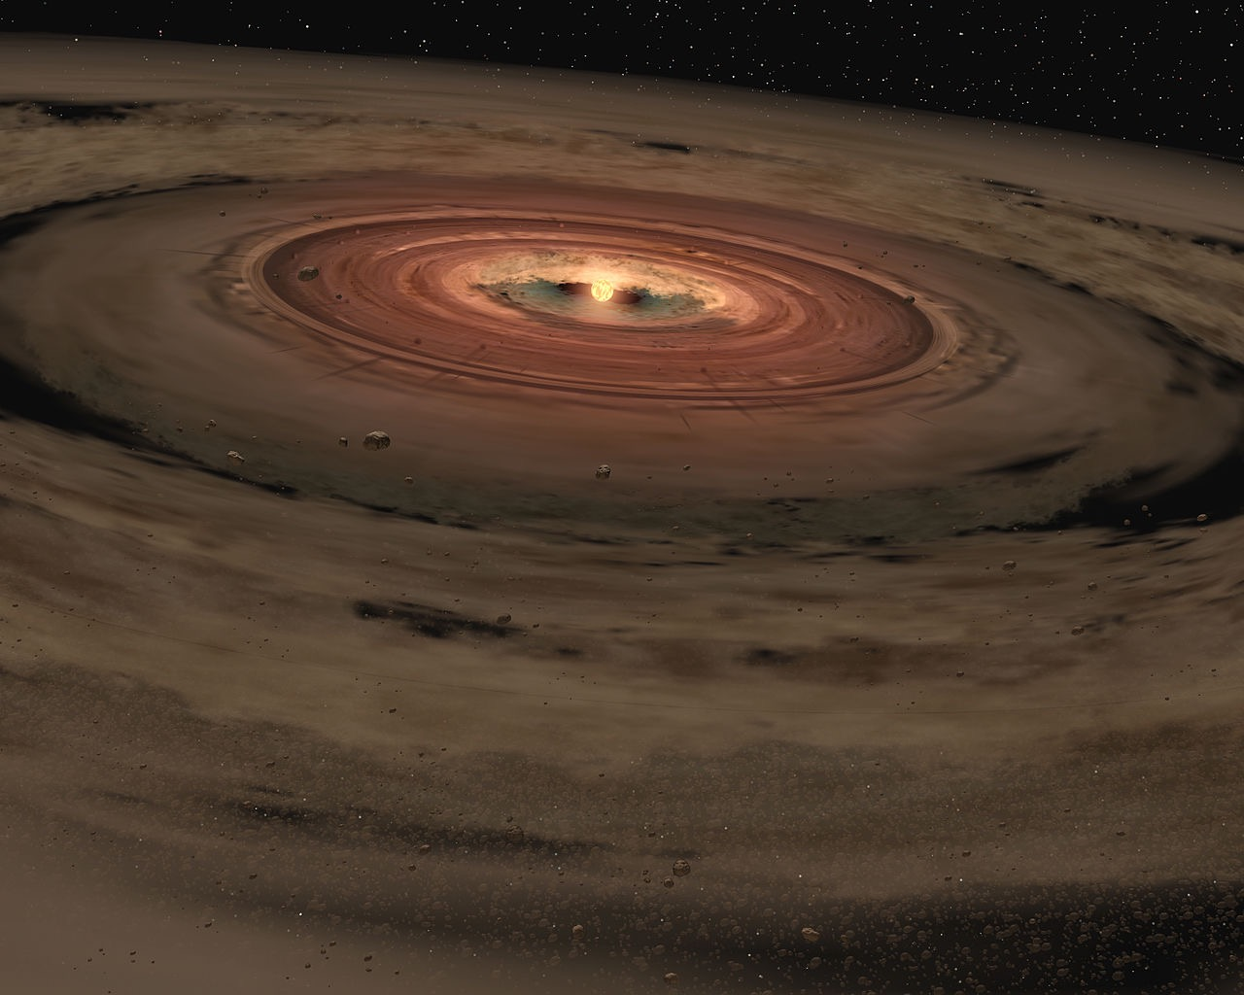

Accretion disks
in astrophysics
Example:
Protostellar discs
Supermassive Black Holes in AGNs
Mergers of neutron star binaries
Image Credit: NASA Jet Propulsion Lab
Notes:
Observe Jets, directly image HL tau ALMA
Accretion disk at Eddington Luminosity
Eddington Luminosity: radiation ≈ gravitational pressure
∵ radiation pressure at center ∴ disc → roughly toroidal shape
high internal temperature
→ ∇ P gets large enough so that not just Fc=Fg
→ deviation from Keplarian → Constant angular momentum

Slide 3

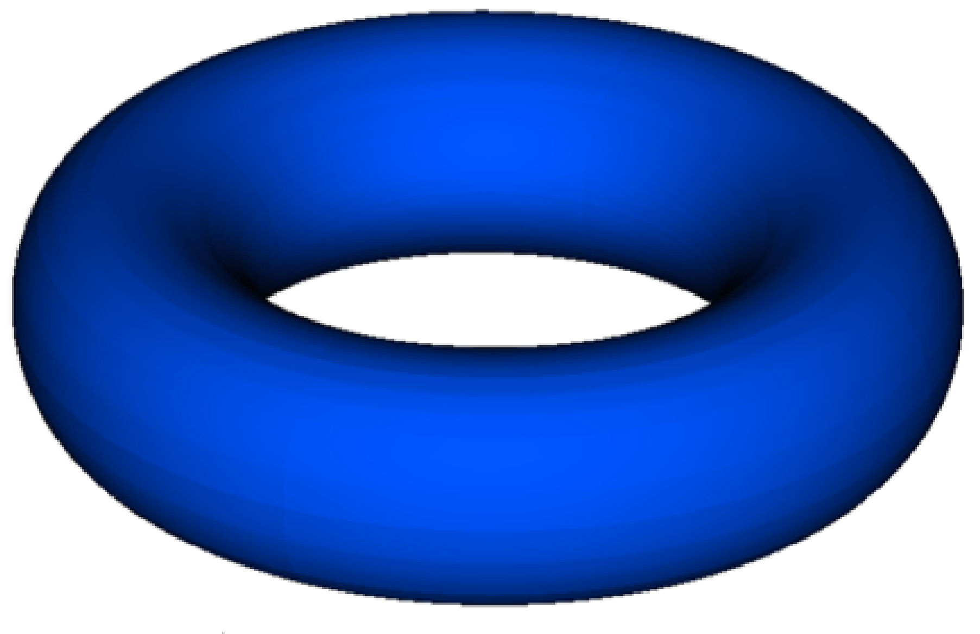

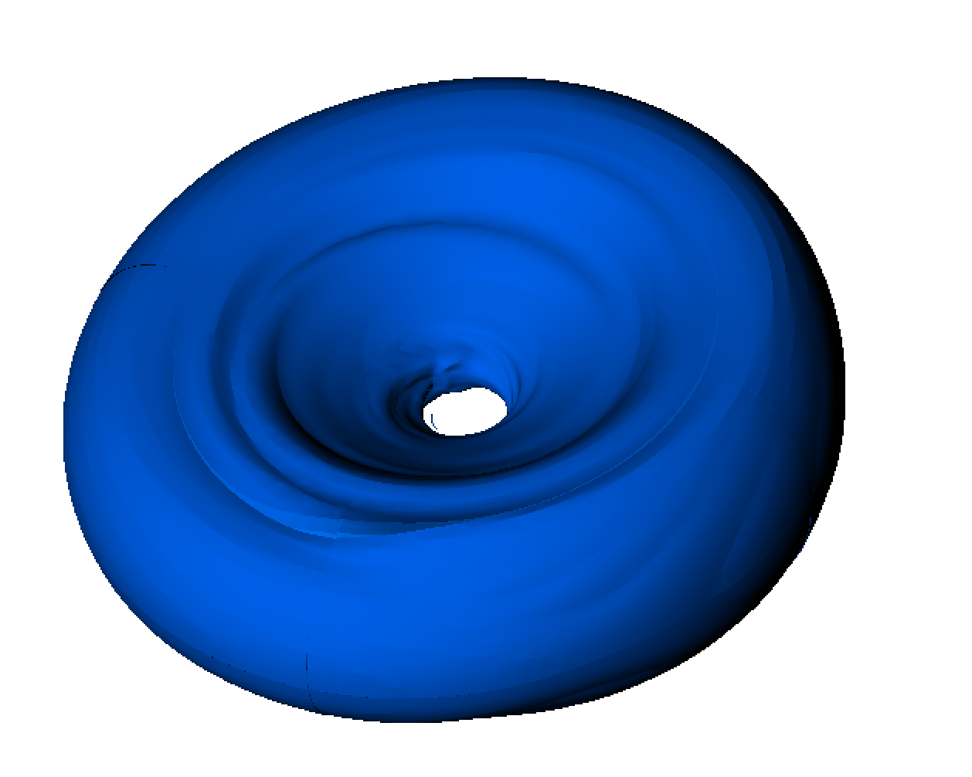
Papaloizou-Pringle Instability
hydrodynamic, global instability
constant angular momentum
Corotation amplification mechanism
Notes:
- PPI 1984 show tori unstable to non-axisymmetric global modes
-Initial condition: hydrostatic EQM
- rotational velocity profile constant angular momentum
- global : not show up in local stability analysis (Rayleigh criterion)
Before MRI, PPI was possible mechanism for generating turbulent viscosity for L transport.
Academic Interest: exist analytical sol’n
verify with Athena ++ code

Slide 4
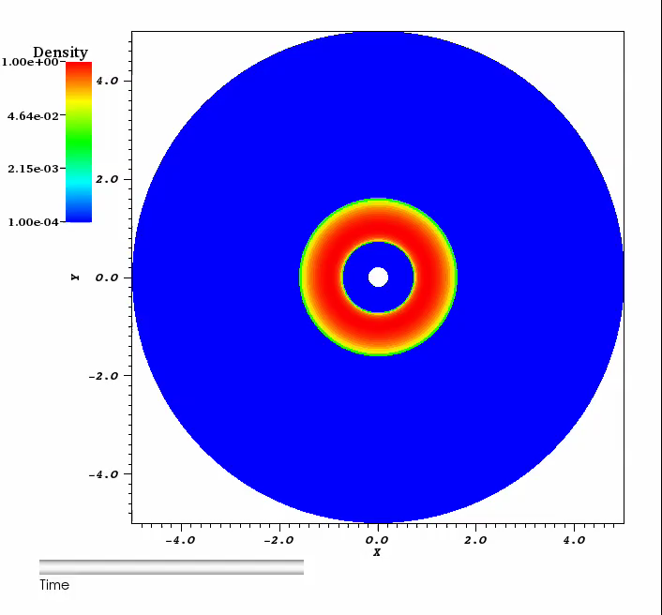
Simulation SETUP & results
Athena ++, HLLC Solver
96x64x128
Log-gridding
24~96 cores, MPI
NERSC Hopper & Edison supercomputer
Notes:
Initial Condition:
hydrostatic EQM (just stay there)
pseudo-Newtonian Potential
- Perturbation: Eigenmode versus entropy in grid
- Log gridding factor 1.03 → ambient condition
- Numerical → suppress instability → High-Res
- Even though instability kicks in at < 10 orbits, carry to nonlinear regime until the pressure maximum spiral into the innermost boundary to track evolution of torus
- Qualitatively, agree with isodensity contour Hawley

Slide 5
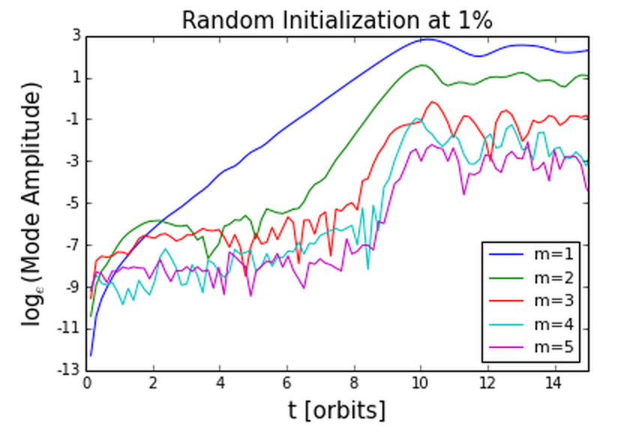
Mode Growth analysis
Notes:
- Integrated mass , Fourier decomposition along phi direction
dominant m=1 growth then mode coupling cause higher order mode to grow much faster
Computed mode growth, Agree with analytical prediction (GGN (1985) , Hawley…etc)
But, instability saturates, doesn’t give significant angular momentum transport→ MRI

Slide 6
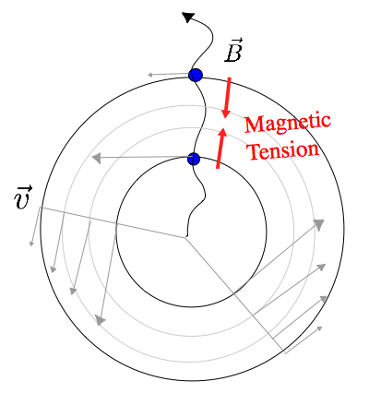
Magnetorotational instability (MRI)
Notes:
β ≈ 400; Aphi = rho^2/ beta_0 → weak B(r,θ)
local, MHD instability (Balbus Hawley 1991)
now widely accepted to be the mechanism of L transport in ionized accretion disc.
initialized the same as PPI case, hydrostatic EQM rotating torus,
now + subthermal,poloidal magnetic field (set up by defining a A-phi)
we use the same velocity profile as the const angular momentum case, but not required for the instability to work (Keplerian V is okay)
Maxwell and Reynold stress of the turbulent state transport angular momentum outward, so gass accretion inward
although local instability, global simulation enable MRI to sample larger wavelength in r and phi

Slide 7
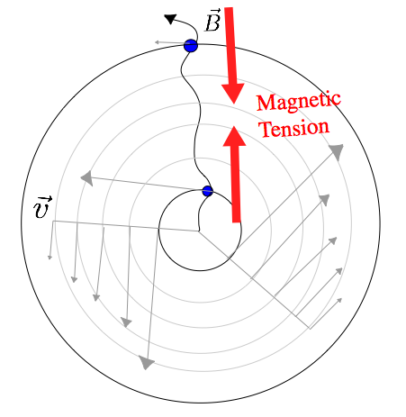
Run-away Instability

Slide 8
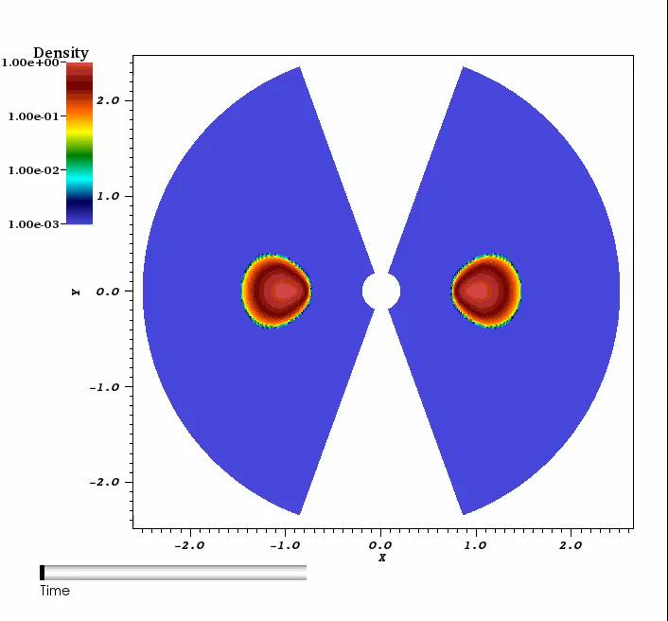
SIMULATION RESULTS

Slide 9
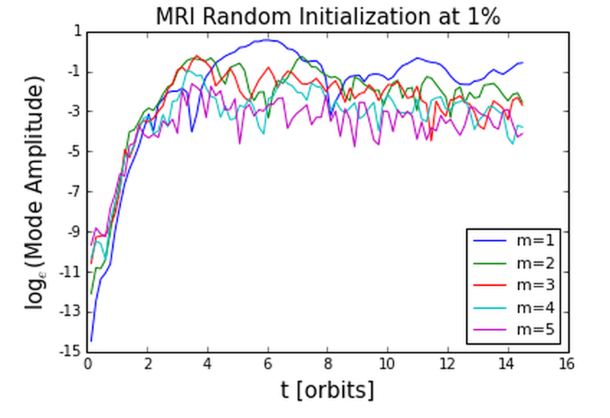
MRI Mode growth analysis
Notes:
m=1 no longer dominant mode, other modes are comparable
The fastest growing mode is m= (?)
- obtained growth rates
-agree with previous literature …etc
MRI effective in outward angular momentum transport in disc

Slide 10
Summary
Papaloizou Pringle Instability | Magnetorotational Instability
Global, nonaxisymmetric, Hydrodynamical | Local, (axisymmetric?) , MHD
Constant Angular Momentum | Keplerian profile
m=1 mode dominant | higher order modes dominant
Does provide angular momentum transport, but not great. | Effective Angular momentum Transport

Slide 11
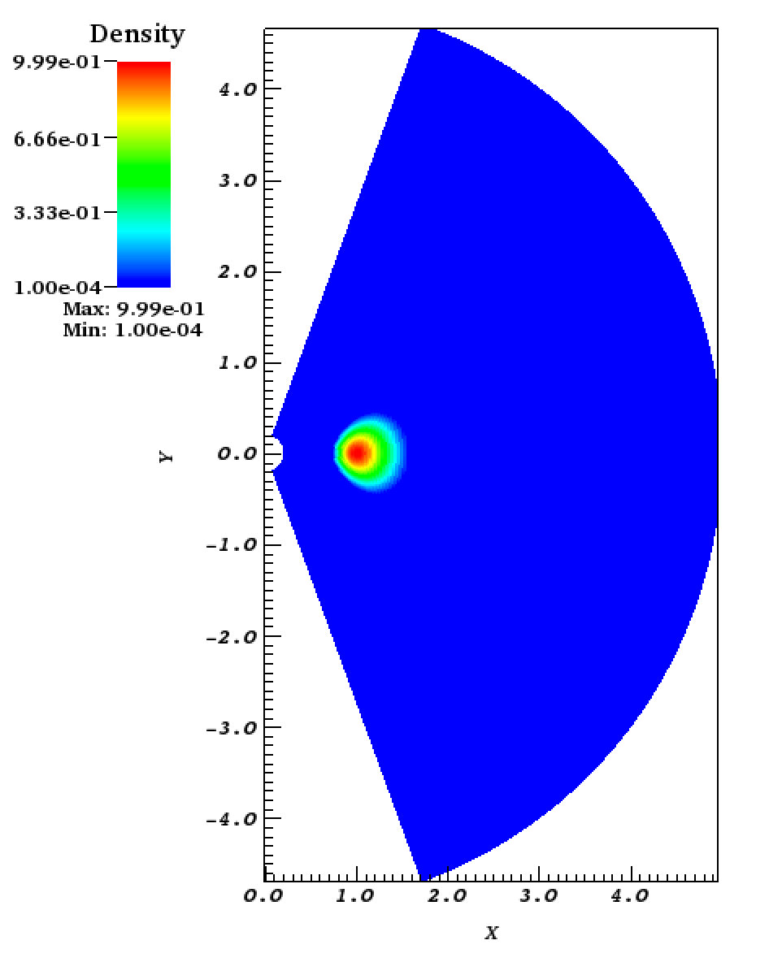
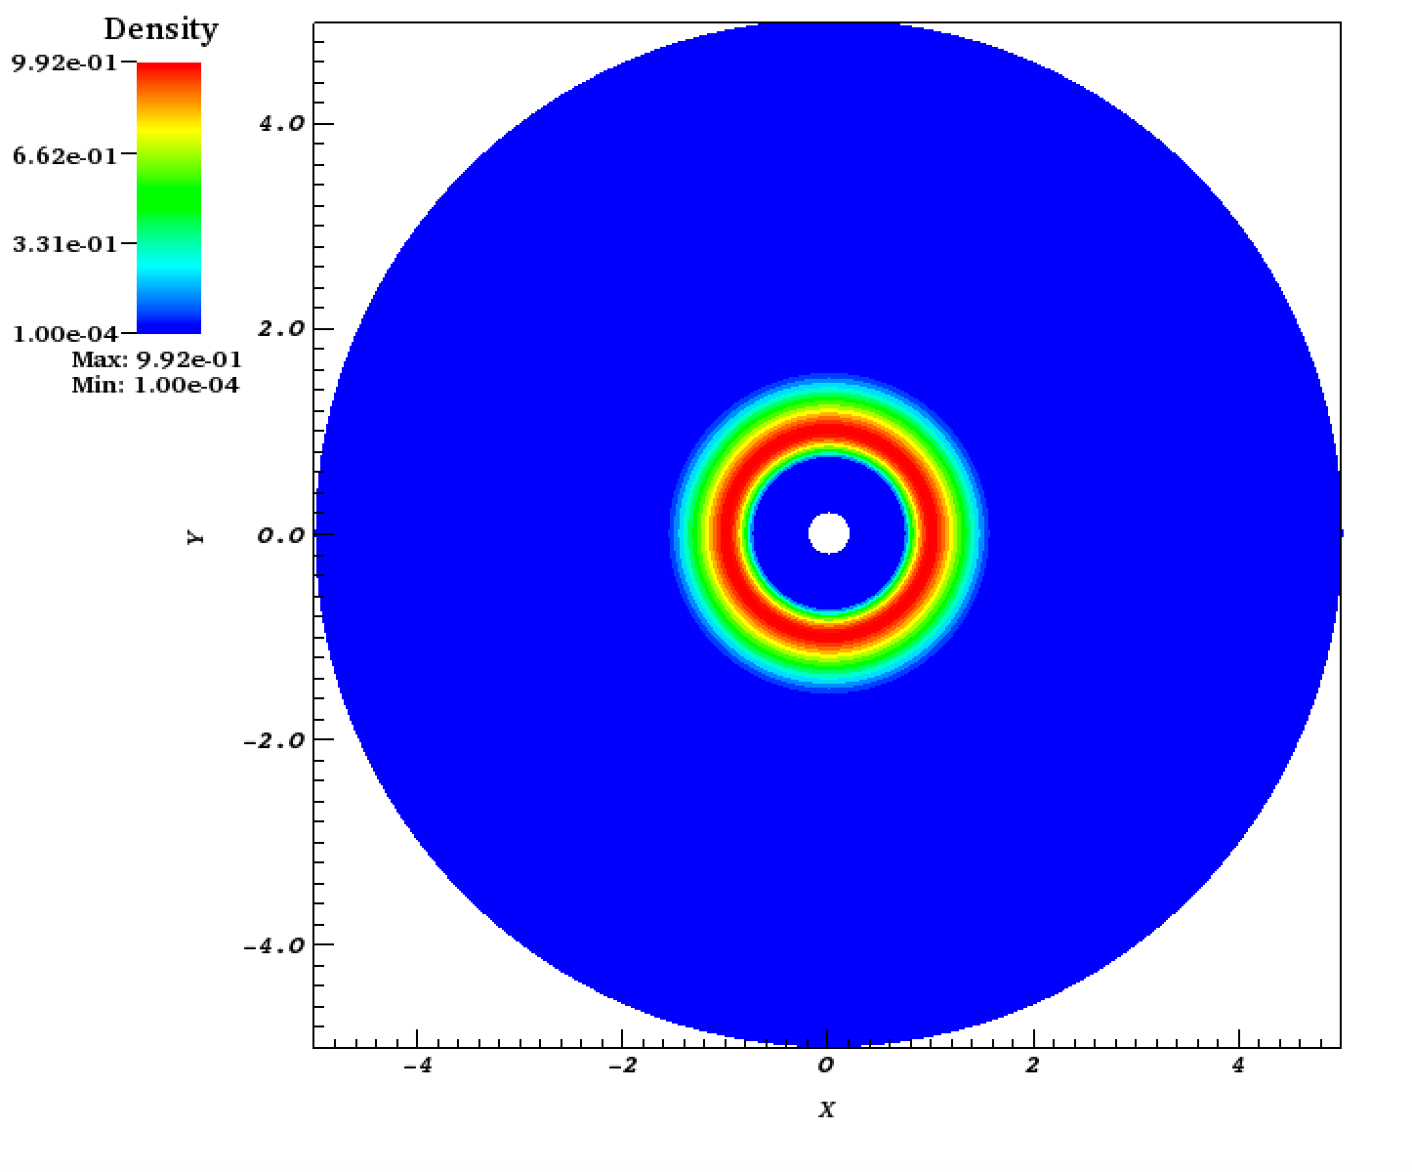
Simulation setup
Notes:
linear stability analysis analytical but non linear regime can only be studied with simulation

